Slide 1

Week 9 Presentation
Team members
Sanjana
Jashandeep
Arshpreet

Slide 2


AGENDA IN THIS WEEK
Wireframes With Enhanced Features
UML d i a g r a m s with enhanced features
Review of Client
Update User Stories
W h a t ’ s N e x t
C l o s i n g
2

Slide 3

Wireframes done by Sanjana Student Portal

Slide 4

Enter GPA

Slide 5

Fill Template with SFIA Goals

Slide 6

Project Preference

Slide 7
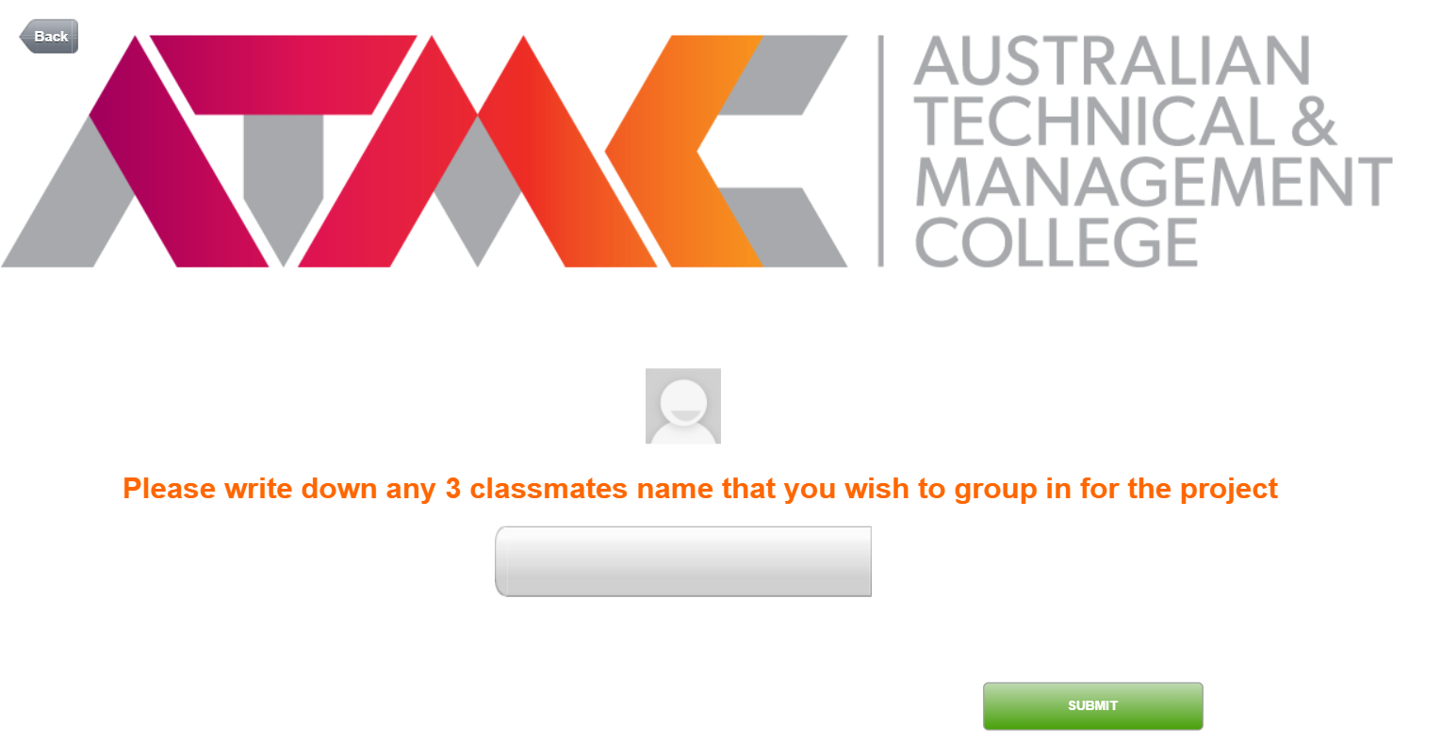
Preference of choosing classmates

Slide 8

Notification

Slide 9

Staff Portal

Slide 10

Menu

Slide 11
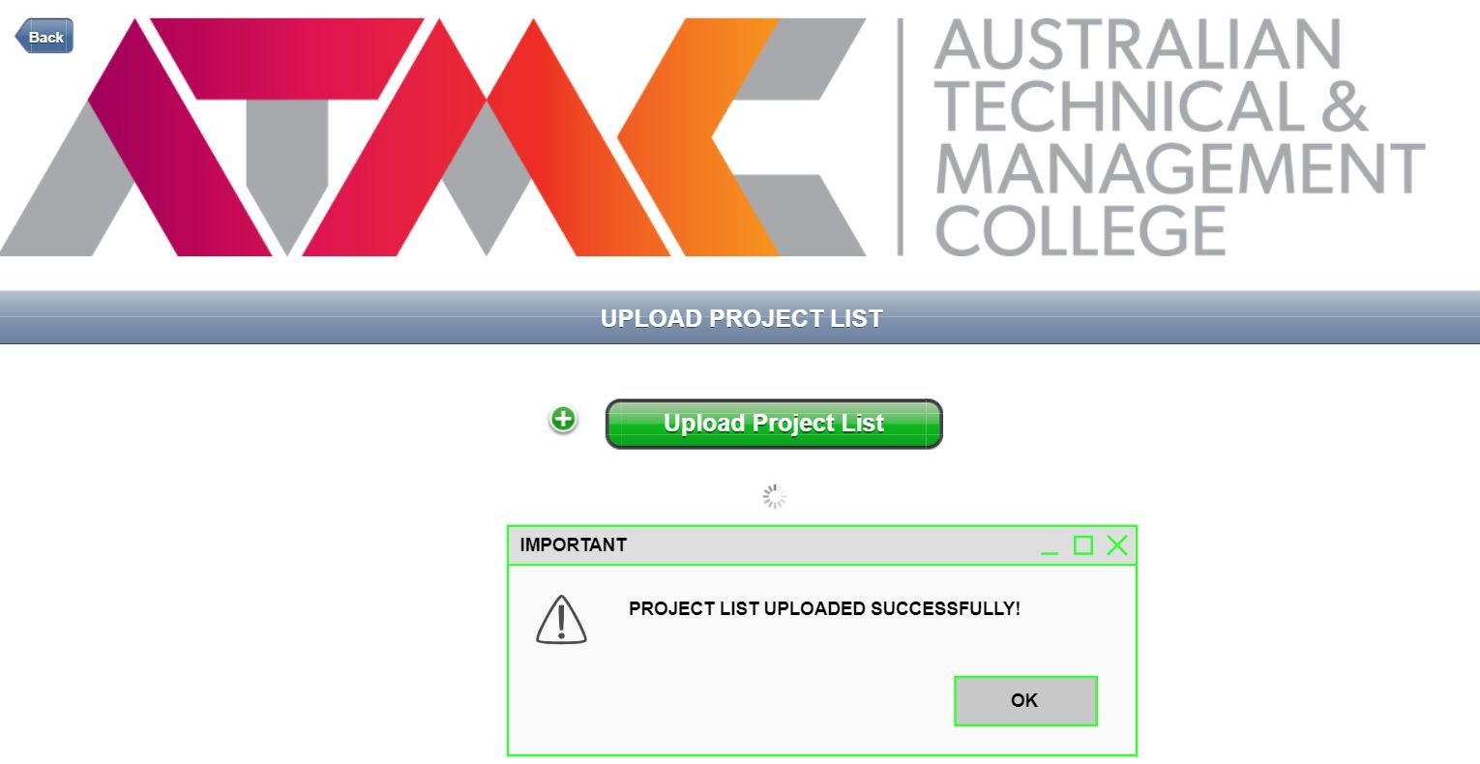
Upload list of Projects

Slide 12

View Groups

Slide 13
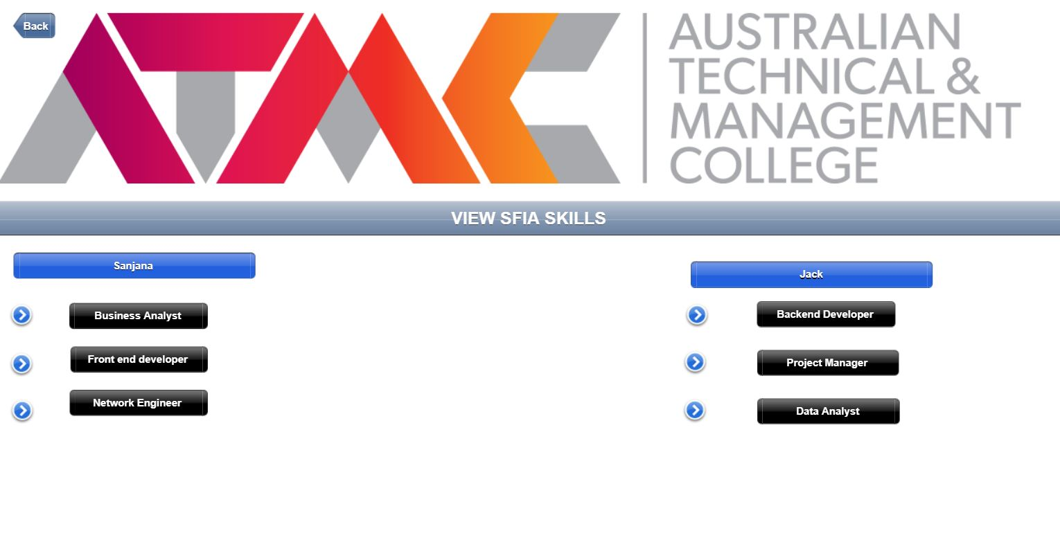
View SFIA Skills

Slide 14
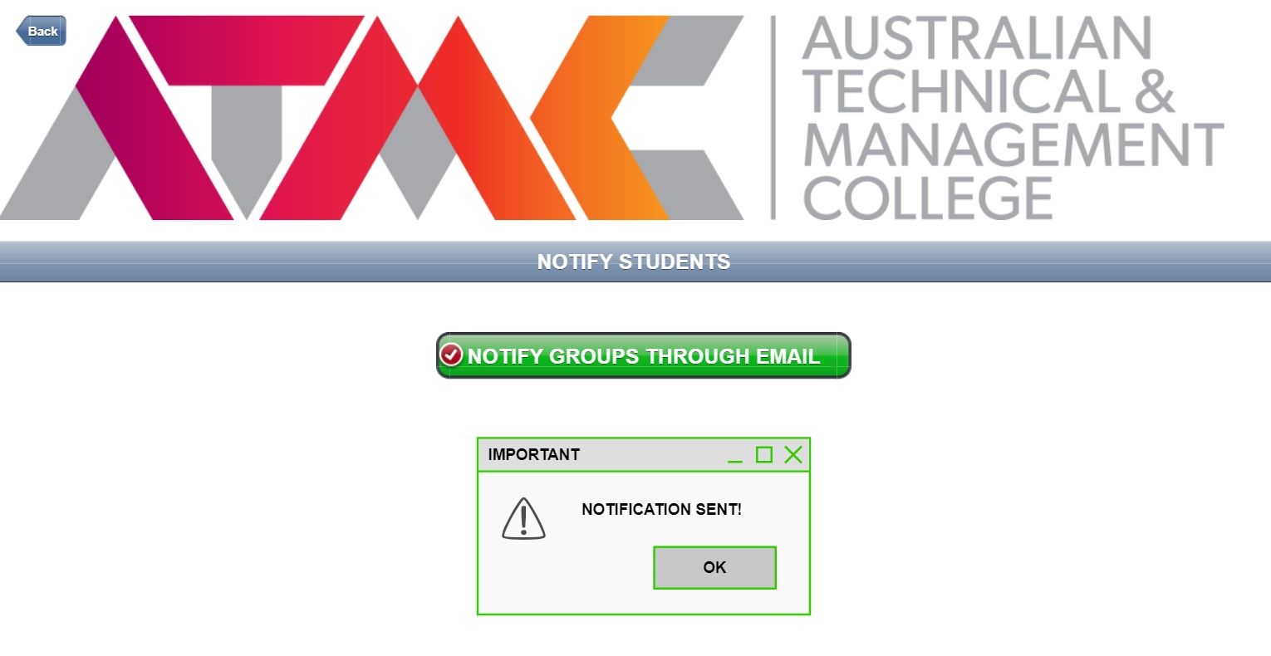
Notify Students

Slide 15
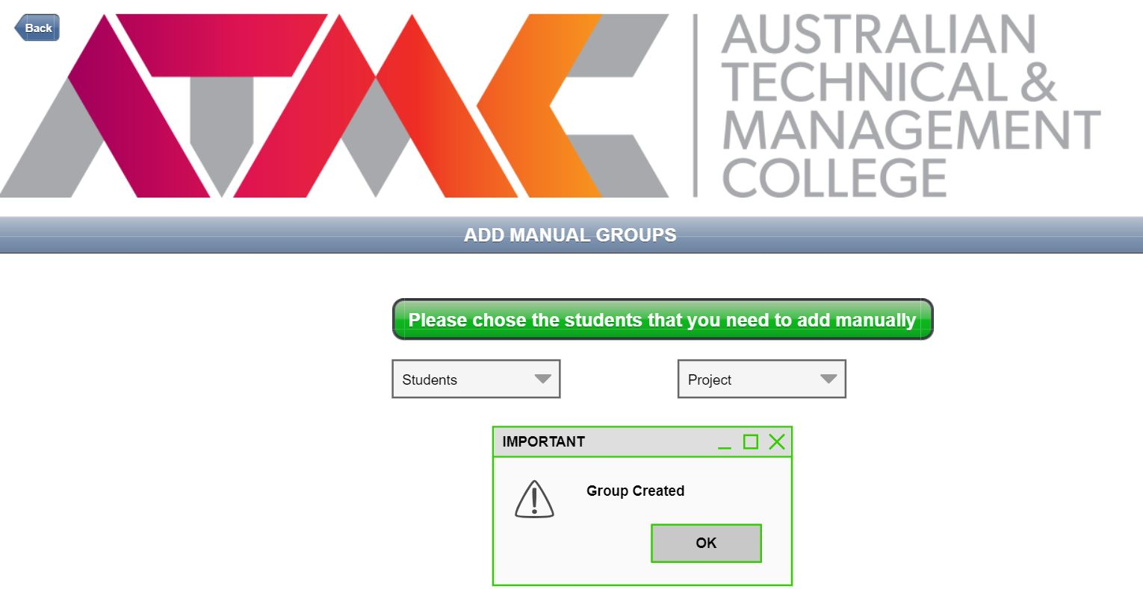
Option for adding Students Manually

Slide 16
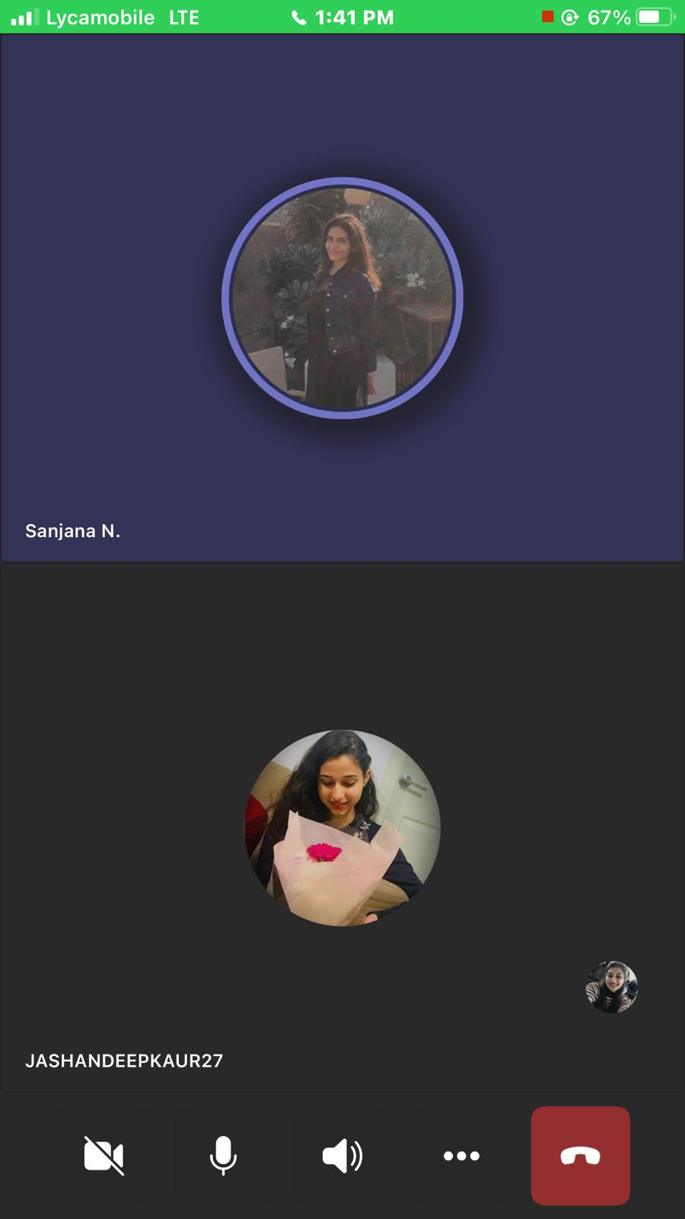
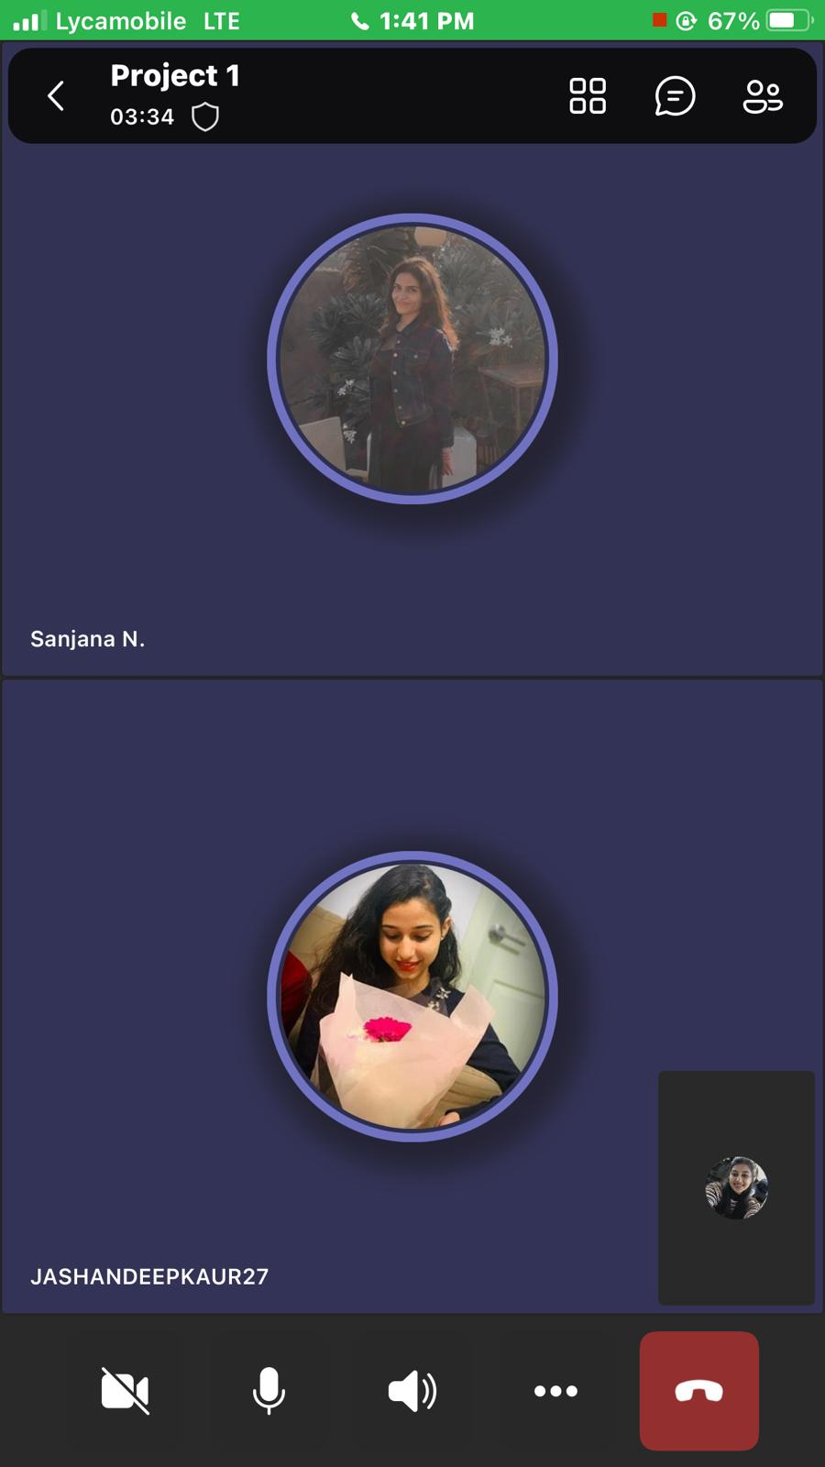
Team Meetings

Slide 17
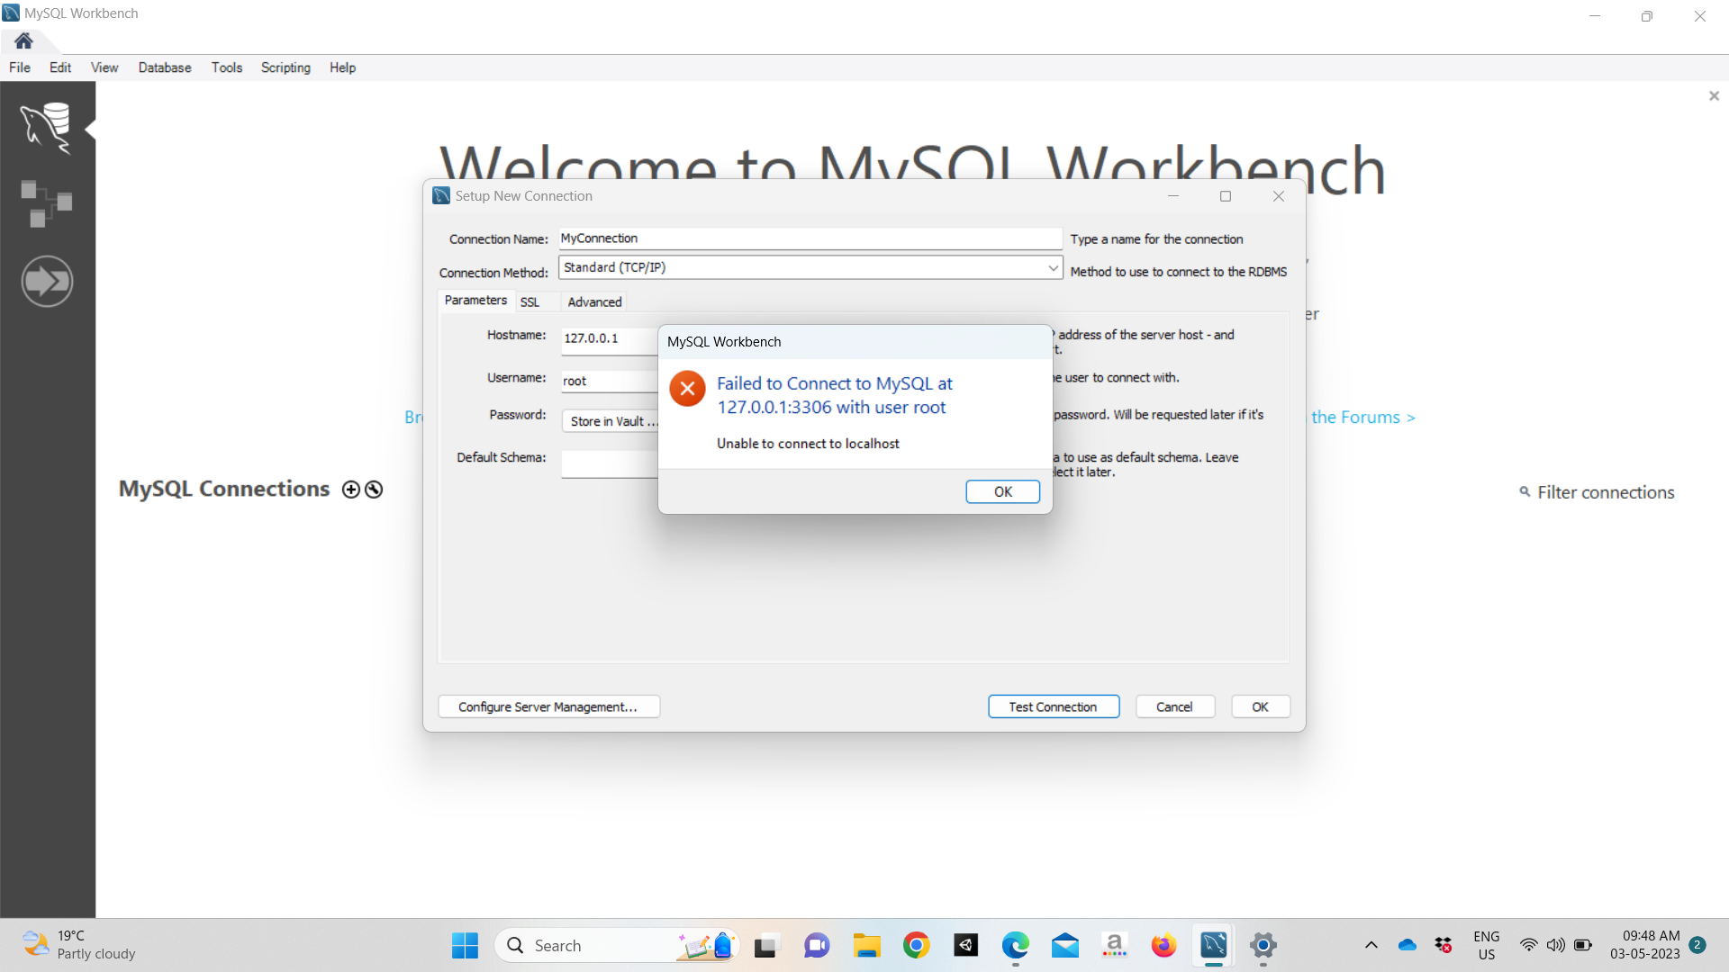
Arshpreet has tried working on database but Mysql isn’t connecting to her database

Slide 18
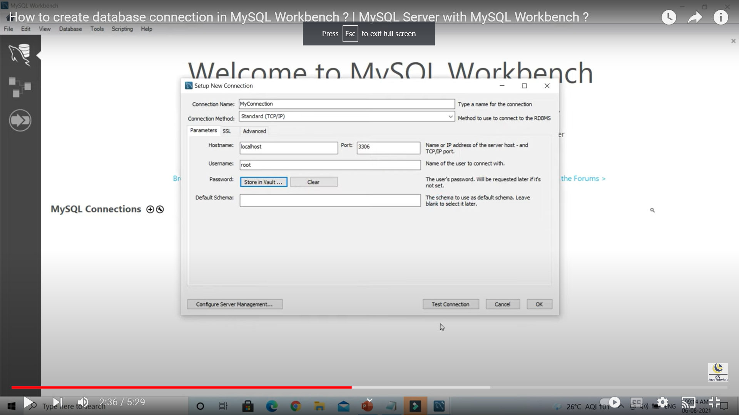
Arshpreet has tried working on database but Mysql isn’t connecting to her database even after watching few videos

Slide 19
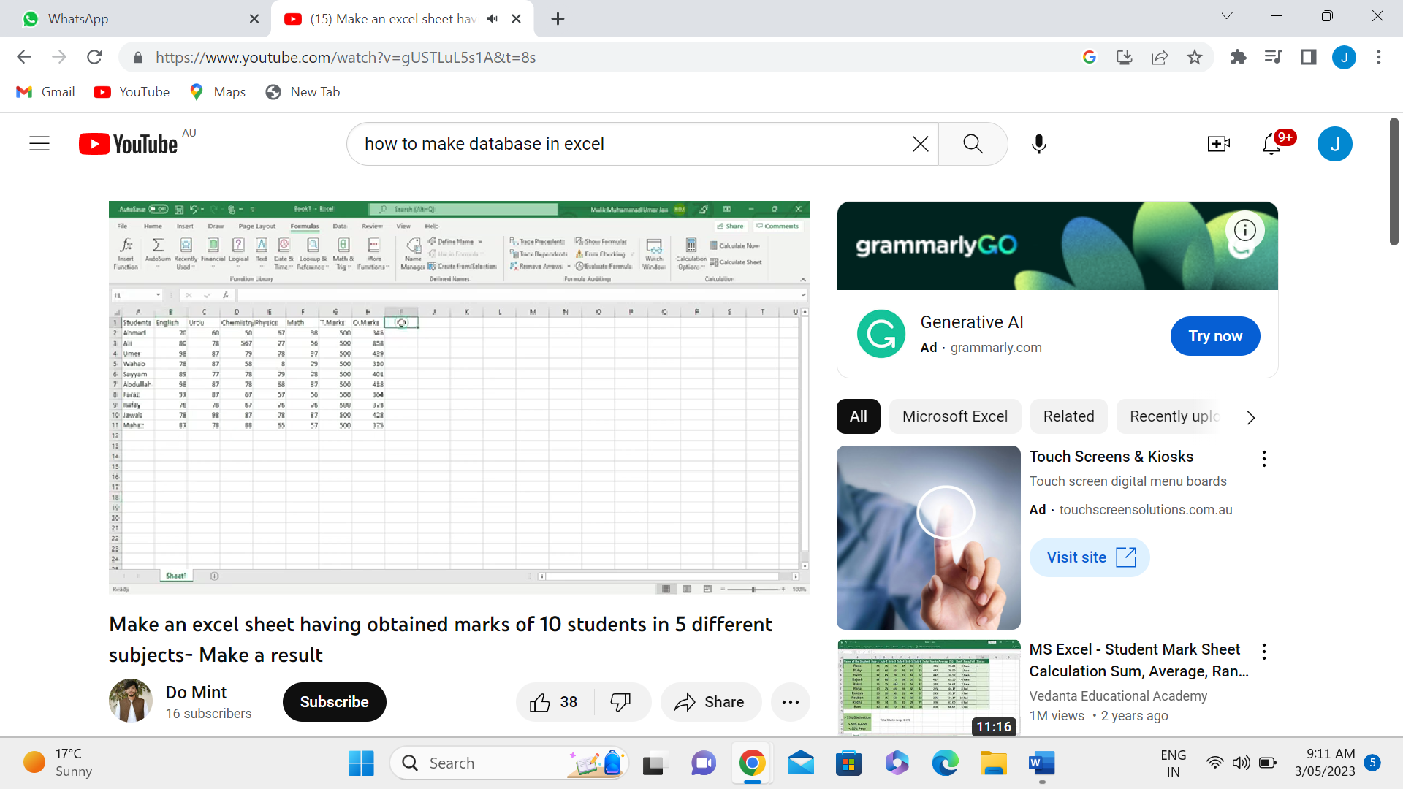
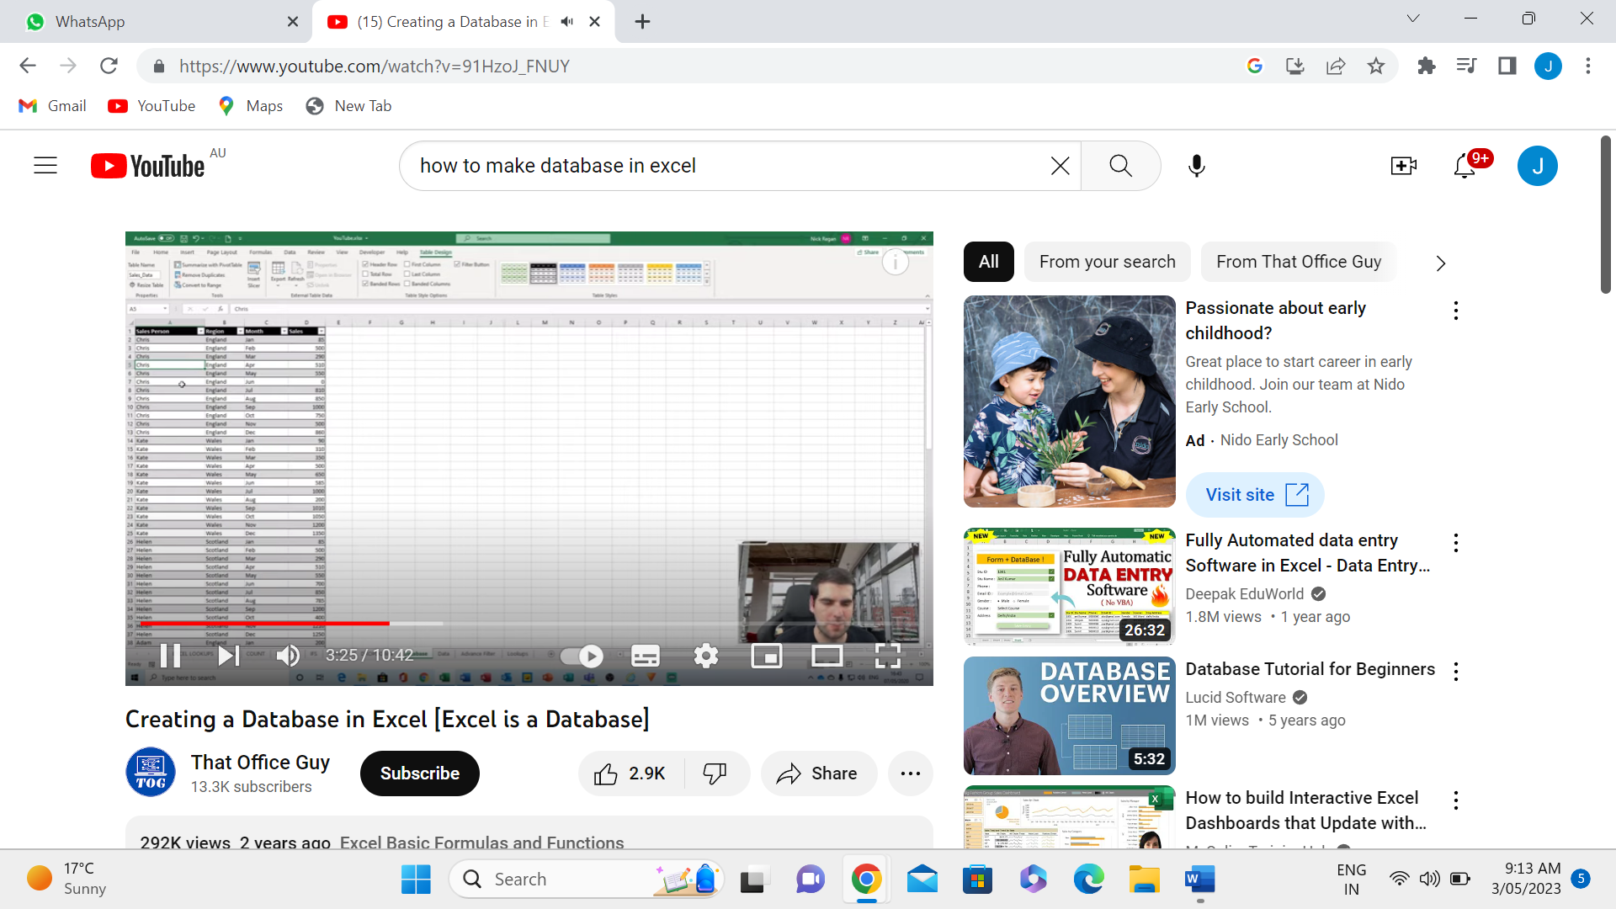
Work Done by Jashandeep kaur
Firstly, I watched a few video on You-tube for creating Database on excel. Here is some screenshots from videos:

Slide 20
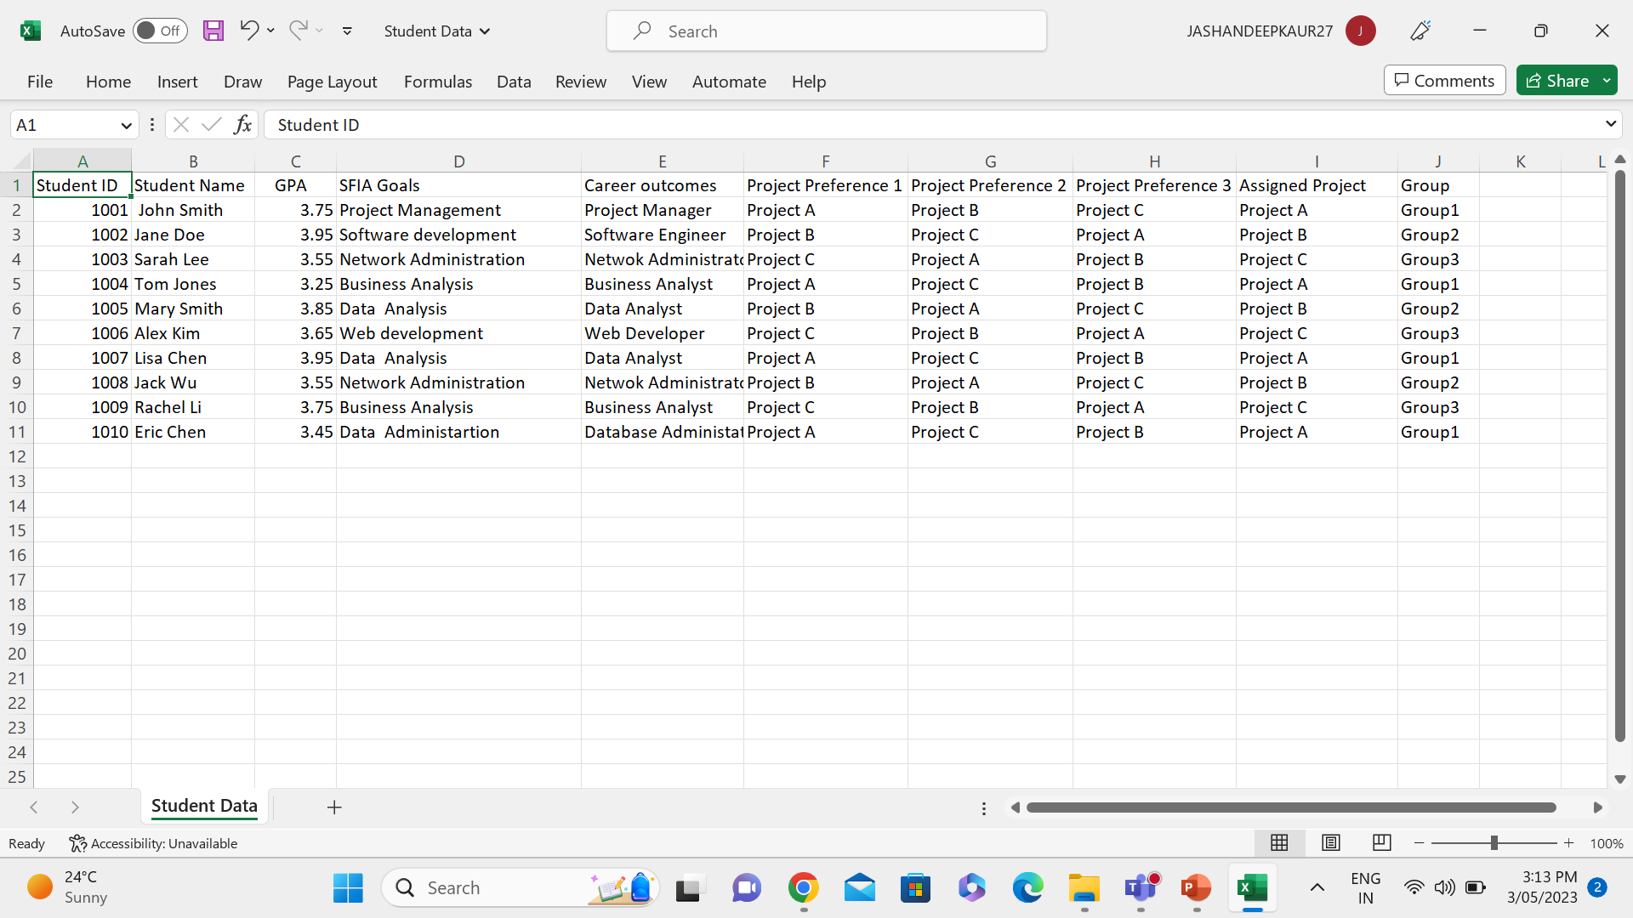
Excel sheet of Student Database

Slide 21
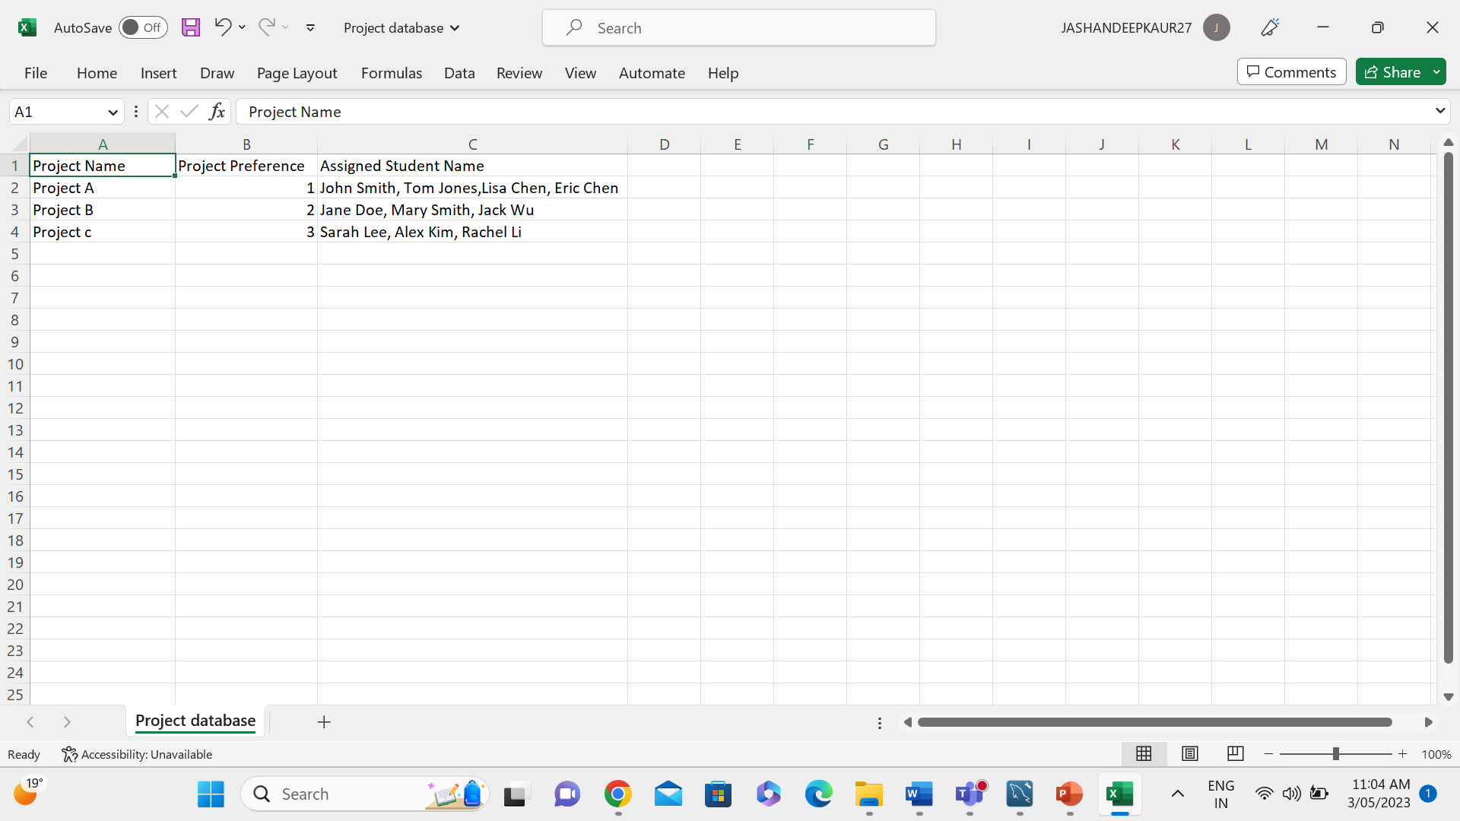
Excel sheet of Project Database

Slide 22
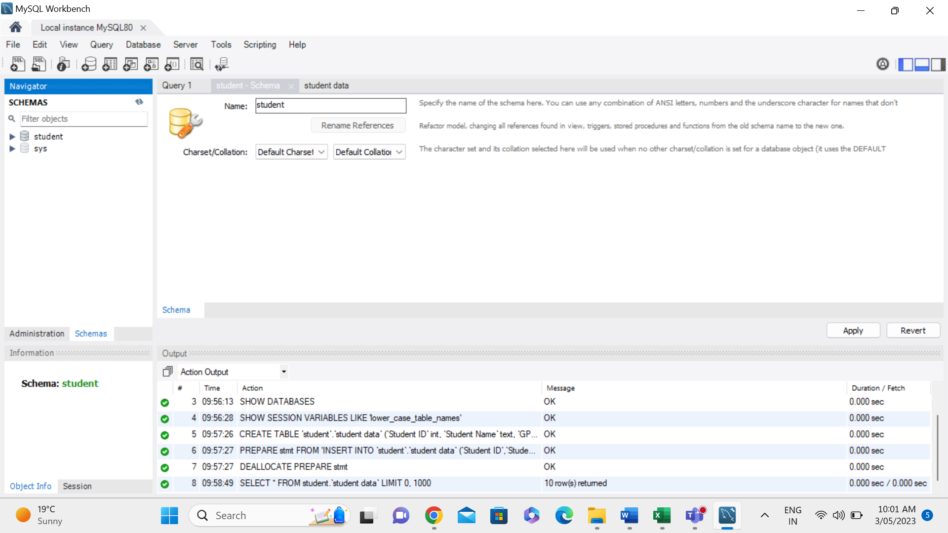
Import Student data file in MySQL
Firstly, I have imported student data file into MySQL by creating Student Schemas.

Slide 23
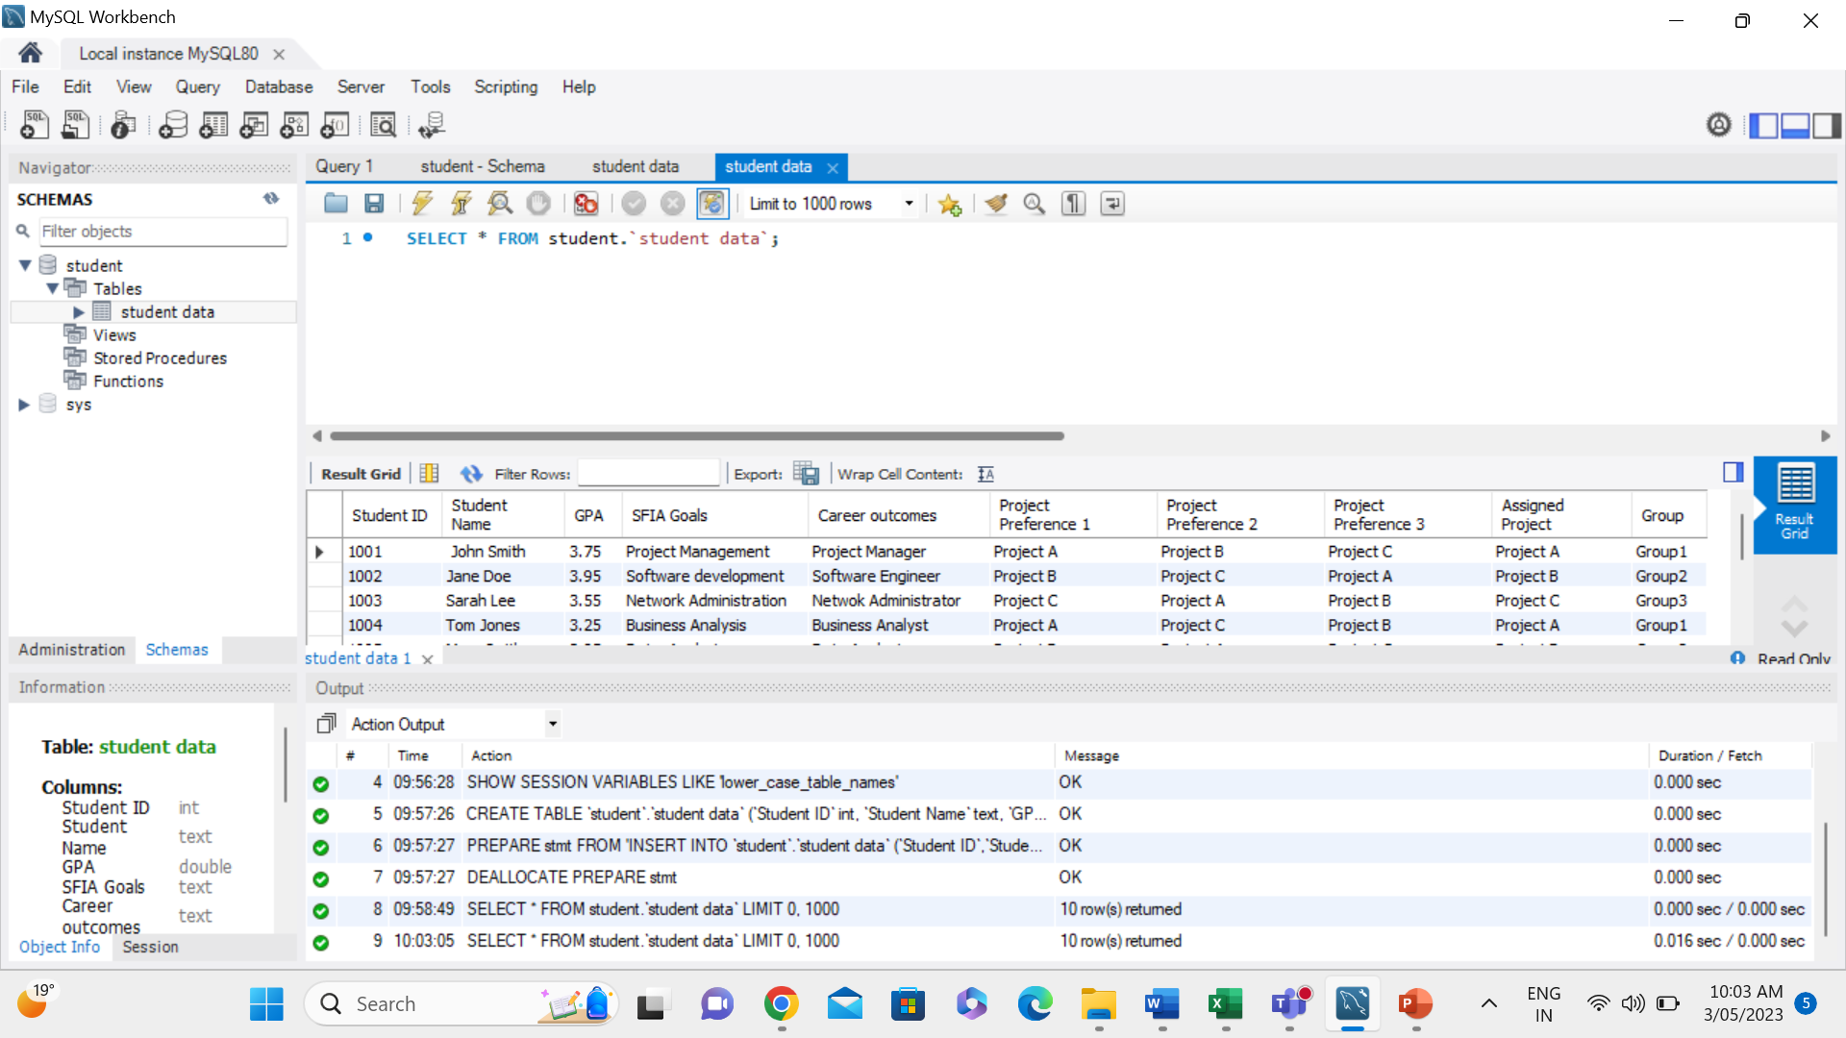
Student Data Table
Successfully imported data as a table

Slide 24
Import Student data file in MySQL
Firstly, I have imported student data file into MySQL by creating Student Schemas.

Slide 25
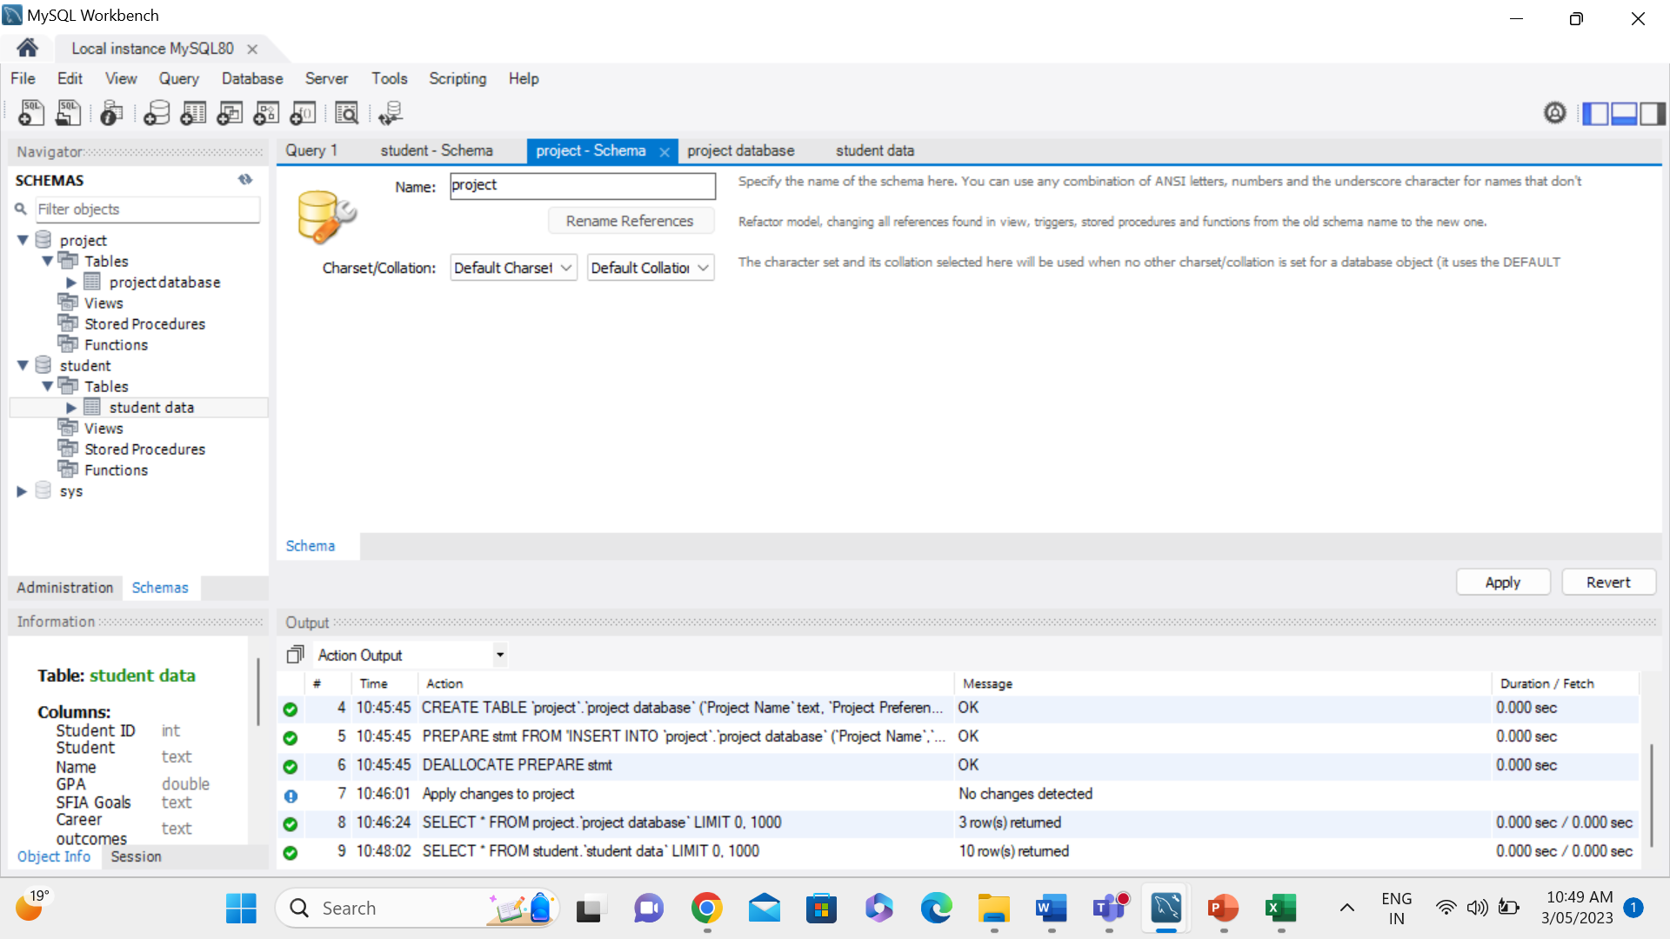
Import Project Data file into MySQL
This time I have imported file of project data, I got few errors in this file. This file has failed to execute many times after that I made some changes for getting a result

Slide 26
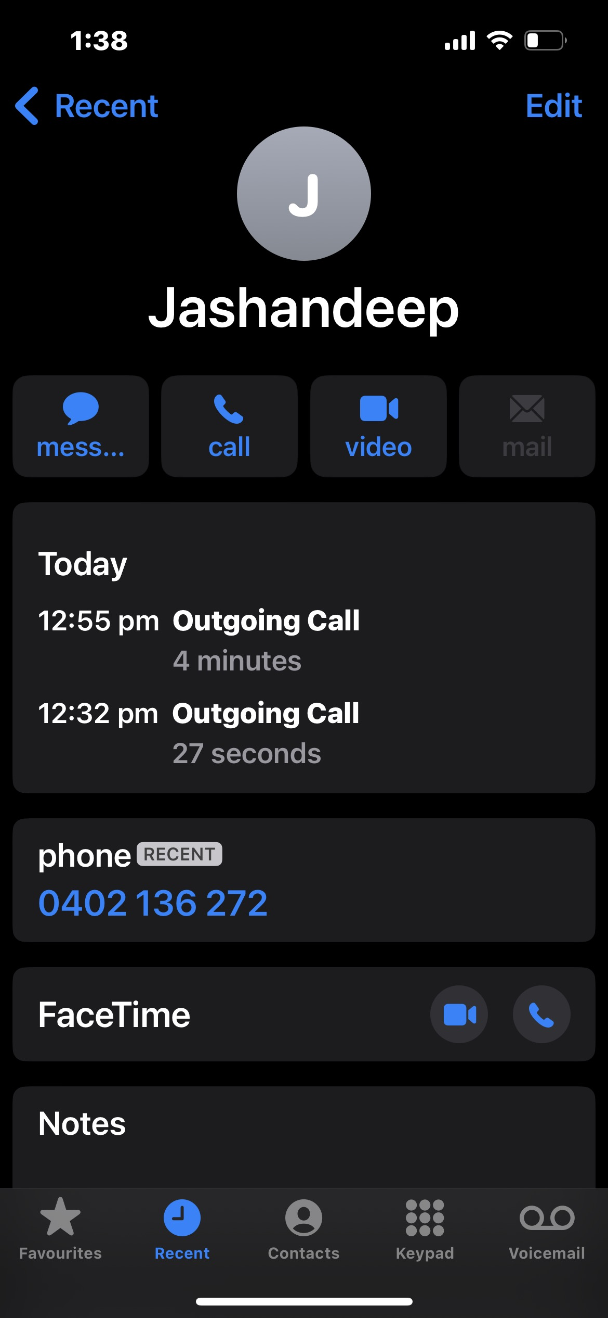
After Discussing through meetings and working out

Slide 27
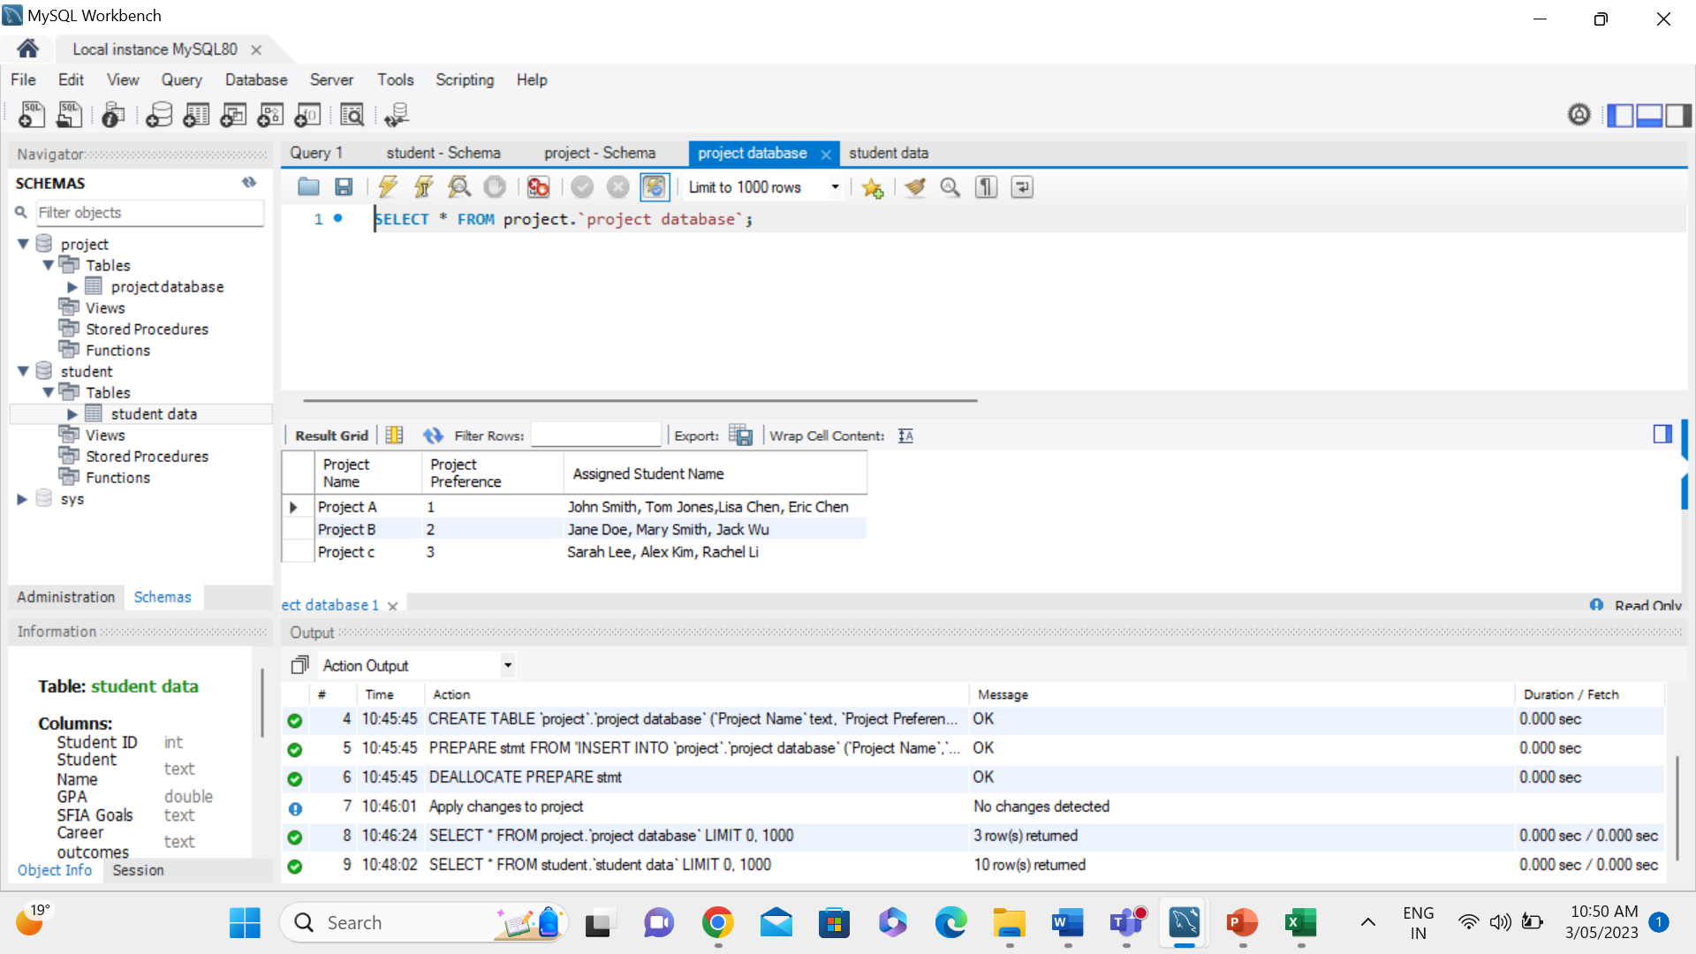
Project Data Table
Successfully got the project database

Slide 28
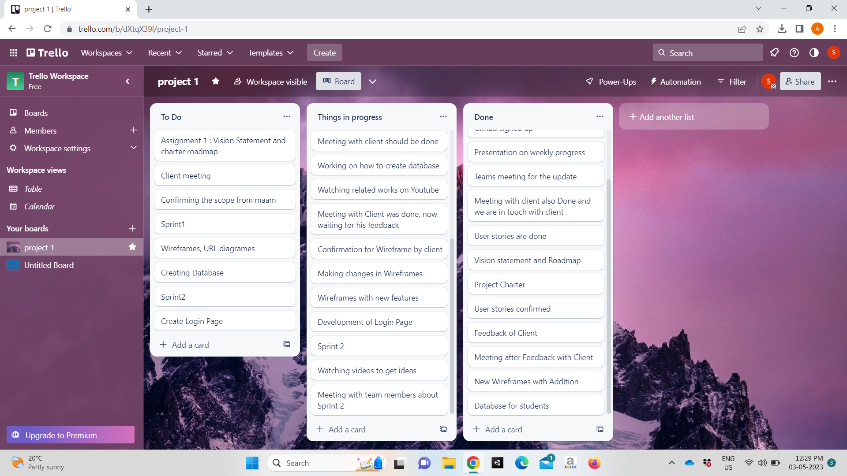
Trello

Slide 29
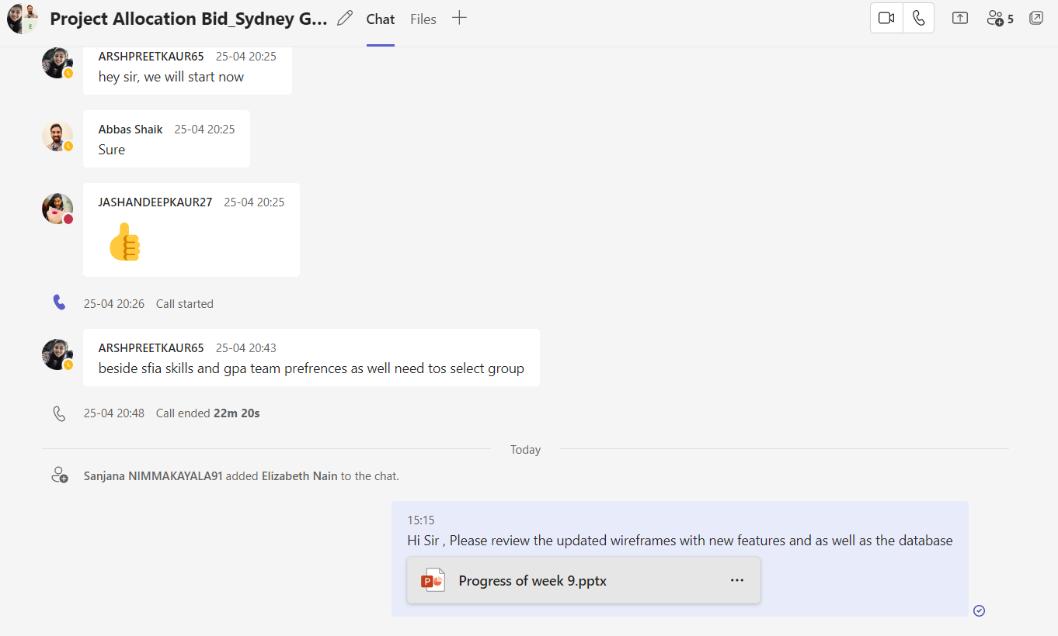
Awaiting Client’s Feedback

Slide 30
What’s Next?
Updated User Stories with story points
Updated Product Backlog
UML Diagrams
Client Feedback
Login page
Testing of the login Page by week 10

Slide 31

Thank you

